Slide 1

Marathwada Shikshan Prasarak Mandal’s
Deogiri Institute of Engineering and Management Studies,
Aurangabad
Year- 2019-2020
Subject : Theory Of Computation
Continuous Assessment II
Presentation
On
A program on Finite Automata
Submitted By
Ankit Sakhare (36009)
Arjun Mundhe (36010)
Guided By
Mrs. Sarika Chavan

Slide 2
Introduction
Definition:
A finite automaton (FA) is a simple idealized machine used to recognize patterns within input taken from some character set (or alphabet) . The job of an FA is to accept or reject an input depending on whether the pattern defined by the FA occurs in the input.
Finite Automata Consist of 2 Types:
Deterministic Finite Automata (DFA)
Nondeterministic Finite Automata(NFA)

Slide 3
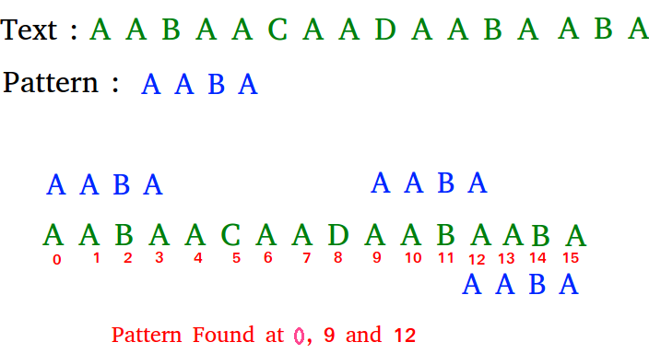
Pattern Searching
Pattern searching is an important problem in computer science. When we do search for a string in notepad/word file or browser or database, pattern searching algorithms are used to show the search results.

Slide 4
Example
Input: txt[] = "THIS IS A TEST TEXT"
pat[] = "TEST"
Output: Pattern found at index 10
Input: txt[] = "AABAACAADAABAABA"
pat[] = "AABA"
Output: Pattern found at index 0
Pattern found at index 9
Pattern found at index 12

Slide 5
Application
DNA Sequencing
Image Processing
String matching in bioinformatics
Digital Forensics

Slide 6
Conclusion
We came to know about pattern searching. We can find substring by checking once for the string. It also does not occupy extra space to perform the operation.

Slide 7
Thank You

